Slide 1
Python DS-Code Practice
Dr. Naveen Kumar
Associate Professor
Amity Institute of Information Technology
Amity University Patna

Slide 2
Program for Armstrong Numbers
Given a number x, determine whether the given number is Armstrong's number or not. A positive integer of n digits is called an Armstrong number of order n (order is the number of digits) if
abcd... = pow(a,n) + pow(b,n) + pow(c,n) + pow(d,n) + ....
Here a, b, c and d are digits of input number abcd.....
Examples
Input: n = 153 Output: true Explanation: 153 is an Armstrong number, 1*1*1 + 5*5*5 + 3*3*3 = 153
Input: n = 9474 Output: true Explanation: 9⁴ + 4⁴ + 7⁴ + 4⁴ = 6561 + 256 + 2401 + 256 = 9474
Input: n = 123 Output: false Explanation: 1³ + 2³ + 3³ = 1 + 8 + 27 = 36

Slide 3
Sum of Digits of a Number
Given a number n, find the sum of its digits.
Examples :
Input: n = 687 Output: 21 Explanation: The sum of its digits are: 6 + 8 + 7 = 21
Input: n = 12 Output: 3 Explanation: The sum of its digits are: 1 + 2 = 3

Slide 4
WAP to reverse digits of a number
Given an Integer n, find the reverse of its digits.
Examples:
Input: n = 122 Output: 221 Explanation: By reversing the digits of number, number will change into 221.
Input: n = 200 Output: 2 Explanation: By reversing the digits of number, number will change into 2.
Input: n = 12345 Output: 54321 Explanation: By reversing the digits of number, number will change into 54321.

Slide 5
Primality Test of a Number
Given a positive integer, check if the number is prime or not. A prime is a natural number greater than 1 that has no positive divisors other than 1 and itself. Examples of the first few prime numbers are {2, 3, 5, ...} Examples :
Input: n = 11 Output: true
Input: n = 15 Output: false
Input: n = 1 Output: false

Slide 6
Check if a number is a power of another number
Given two positive numbers x and y, check if y is a power of x or not. Examples :
Input: x = 10, y = 1 Output: True x^0 = 1
Input: x = 10, y = 1000 Output: True x^3 = 1
Input: x = 10, y = 1001 Output: False

Slide 7
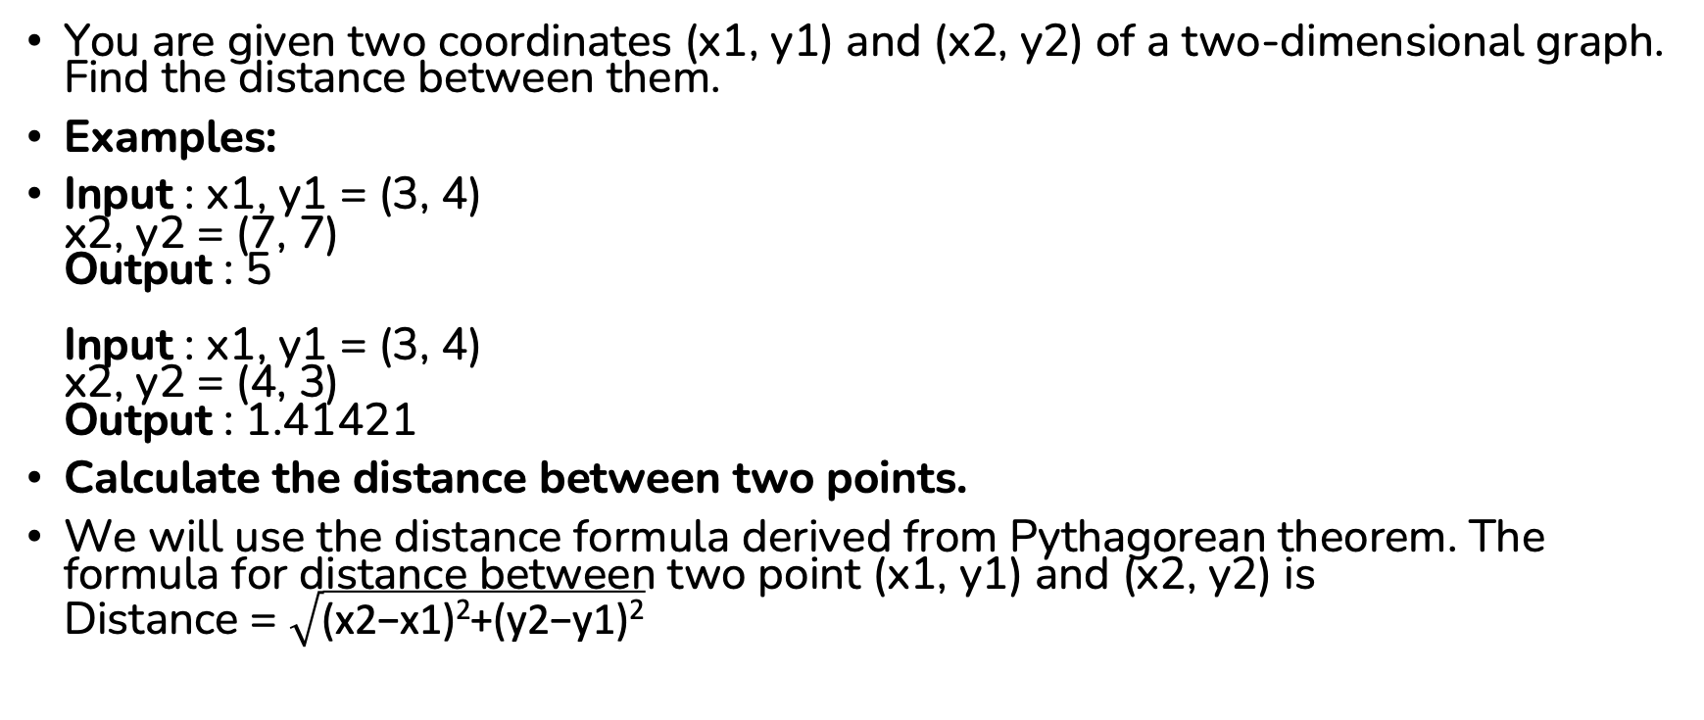
Distance Calculation
You are given two coordinates (x1, y1) and (x2, y2) of a two-dimensional graph. Find the distance between them.
Examples:
Input : x1, y1 = (3, 4) x2, y2 = (7, 7) Output : 5 Input : x1, y1 = (3, 4) x2, y2 = (4, 3) Output : 1.41421
Calculate the distance between two points.
We will use the distance formula derived from Pythagorean theorem. The formula for distance between two point (x1, y1) and (x2, y2) is Distance = $\sqrt{\text{(}\text{x}\text{2−}\text{x}\text{1)2+(}\text{y}\text{2−}\text{y}\text{1)2}}$

Slide 8
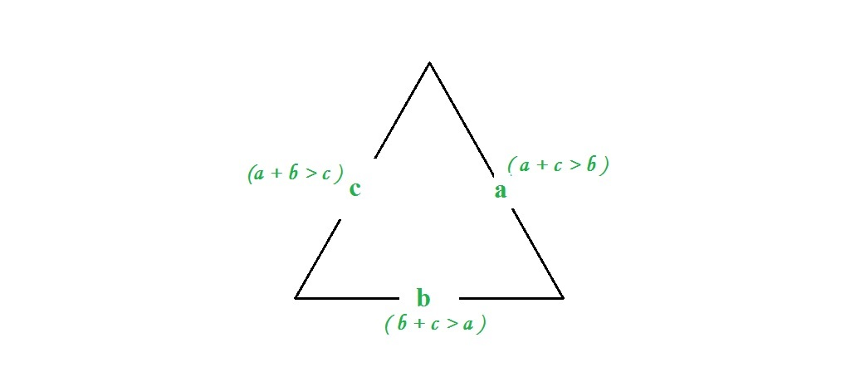
Check whether triangle is valid or not if sides are given
Given three sides, check whether triangle is valid or not.
Examples:
Input : a = 7, b = 10, c = 5 Output : Valid We can draw a triangle with the given three edge lengths. Input : a = 1, b = 10, c = 12 Output : Invalid We can not draw a triangle with the given three edge lengths.

Slide 9
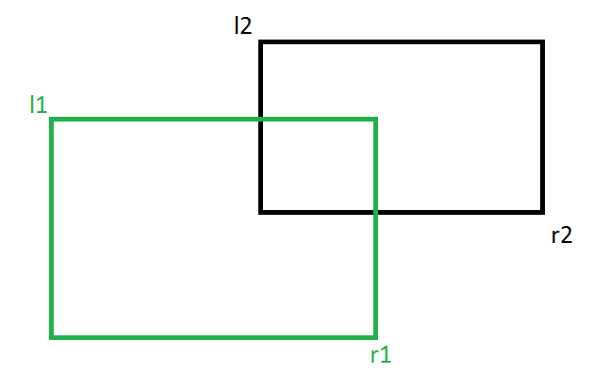
Find if two rectangles overlap
Given two rectangles, find if the given two rectangles overlap or not. Note that a rectangle can be represented by two coordinates, top left and bottom right. So mainly we are given following four coordinates. l1: Top Left coordinate of first rectangle. r1: Bottom Right coordinate of first rectangle. l2: Top Left coordinate of second rectangle. r2: Bottom Right coordinate of
second rectangle.

Slide 10
Factorial of a Number
Given the non-negative integers n , compute the factorial of a given number. Note: Factorial of n is defined as n * (n -1) * (n - 2) * ... * 1, for n = 0, factorial is 1.
Examples:
Input: n = 5 Output: 120 Explanation: 5! = 5 * 4 * 3 * 2 * 1 = 120
Input: n = 4 Output: 24 Explanation: 4! = 4 * 3 * 2 * 1 = 24

Slide 11
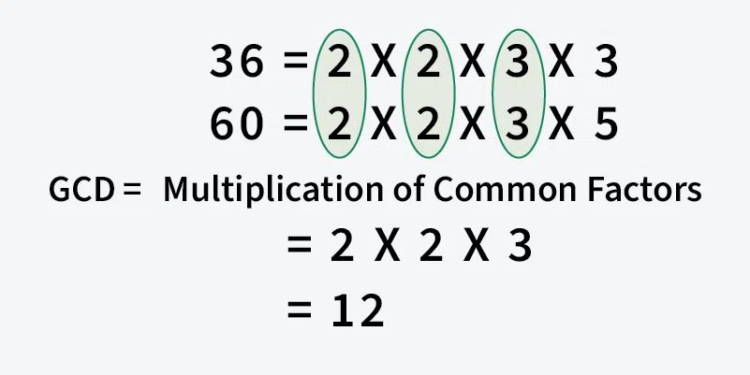
GCD or HCF
Given two positive integers a and b, the task is to find the GCD of the two numbers.
Note: The GCD (Greatest Common Divisor) or HCF (Highest Common Factor) of two numbers is the largest number that divides both of them.
Examples:
Input: a = 20, b = 28 Output: 4 Explanation: The factors of 20 are 1, 2, 4, 5, 10 and 20. The factors of 28 are 1, 2, 4, 7, 14 and 28. Among these factors, 1, 2 and 4 are the common factors of both 20 and 28. The greatest among the common factors is 4.
Input: a = 60, b = 36 Output: 12 Explanation: GCD of 60 and 36 is 12.

Slide 12
LCM of Two Numbers
Given two positive integers a and b. Find the Least Common Multiple (LCM) of a and b. LCM of two numbers is the smallest number which can be divided by both numbers.
Input : a = 10, b = 5 Output : 10 Explanation : 10 is the smallest number divisible by both 10 and 5
Input : a = 5, b = 11 Output : 55 Explanation : 55 is the smallest number divisible by both 5 and 11

Slide 13
Perfect Number
A number is a perfect number if it is equal to the sum of its proper divisors, that is, the sum of its positive divisors excluding the number itself. Find whether a given positive integer n is perfect or not. Examples:
Input: n = 15 Output: false Explanation: Divisors of 15 are 1, 3 and 5. Sum of divisors is 9 which is not equal to 15. Input: n = 6 Output: true Explanation: Divisors of 6 are 1, 2 and 3. Sum of divisors is 6.

Slide 14
Add Two Fraction
Given two integer arrays a[] and b[] containing two integers each representing the numerator and denominator of a fraction respectively. The task is to find the sum of the two fractions and return the numerator and denominator of the result.
Examples :
Input: a = [1, 2] , b = [3, 2] Output: [2, 1] Explanation: 1/2 + 3/2 = 2/1
Input: a = [1, 3] , b = [3, 9] Output: [2, 3] Explanation: 1/3 + 3/9 = 2/3
Input: a = [1, 5] , b = [3, 15] Output: [2, 5] Explanation: 1/5 + 3/15 = 2/5

Slide 15
Find day of the week for a given date
Given a date (day, month, year), the task is to determine the day of the week on which that date falls. The function should be able to compute the day for any date in the past or future. The function should return values from 0 to 6 where 0 means Sunday, 1 Monday and so on.
Examples:
Input: d = 30, m = 8, y = 2010 Output: 1 Explanation: 30th August 2010 was a Monday.
Input: d = 15, m = 6, y = 1995 Output: 4 Explanation: 15th June 1995 was a Thursday.
Input: d = 29, m = 2, y = 2016 Output: 1 Explanation: 26th January was a Monday.

Slide 16
nth Fibonacci number
Given a positive integer n, find the nth Fibonacci number.
The Fibonacci series is a sequence where a term is the sum of previous two terms. The first two terms of the Fibonacci sequence are 0 followed by 1. The Fibonacci sequence: 0, 1, 1, 2, 3, 5, 8, 13, 21.
Example:
Input: n = 2 Output: 1 Explanation: 1 is the 2nd number of Fibonacci series.
Input: n = 5 Output: 5 Explanation: 5 is the 5th number of Fibonacci series.

Slide 17
Palindrome Number
Given an integer n, determine whether it is a palindrome number or not. A number is called a palindrome if it reads the same from forward and backward.
Examples:
Input: n = 12321 Output: True Explanation: 12321 is a palindrome number because it reads same forward and backward.
Input: n = 1234 Output: False Explanation: 1234 is not a palindrome number because it does not read the same forward and backward.

Slide 18
Program for Square Root of Integer
Given a positive integer n, find its square root. If n is not a perfect square, then return floor of √n.
Examples :
Input: n = 4 Output: 2 Explanation: The square root of 4 is 2.
Input: n = 11 Output: 3 Explanation: The square root of 11 lies in between 3 and 4 so floor of the square root is 3.

Slide 19
Sieve of Eratosthenes
Given a number n, find all prime numbers less than or equal to n.
Examples:
Input: n = 10 Output: [2, 3, 5, 7] Explanation: The prime numbers up to 10 obtained by Sieve of Eratosthenes are [2, 3, 5, 7].
Input: n = 35 Output: [2, 3, 5, 7, 11, 13, 17, 19, 23, 29, 31] Explanation: The prime numbers up to 35 obtained by Sieve of Eratosthenes are [2, 3, 5, 7, 11, 13, 17, 19, 23, 29, 31].

Slide 20
Super Prime
Given a positive integer n and the task is to print all the Super-Primes less than or equal to n.
Super-prime numbers (also known as higher order primes) are the subsequence of prime number sequence that occupy prime-numbered positions within the sequence of all prime numbers. The first few super primes are 3, 5, 11, and 17.
Examples:
Input: n = 7 Output: 3 5 Explanation: In list of primes (2, 3, 5, 7}, 3 and 5 are super primes because they appear at 2nd and 3rd positions which are also a prime .
Input: n = 17 Output: 3 5 11 17 Explanation: In list of primes (2, 3, 5, 7, 11, 13, 17), 3, 5, 11 and 17 are super primes because they appear at 2nd, 3rd, 5th and 7th positions which are also a prime .

Slide 21
Tower of Hanoi Algorithm
The Tower of Hanoi is a classic mathematical puzzle involving three rods (A, B, and C) and n disks of different sizes. Initially, all disks are stacked on rod A in decreasing order of diameter - the largest disk at the bottom and the smallest at the top. Goal is to move the entire stack to another rod (rod C) while following these rules:
Move only one disk at a time.
At each step, you can take the top disk from any rod and place it on another rod.
A disk can only be moved if it is the topmost disk of a rod.
No larger disk may be placed on top of a smaller disk.

Slide 22
Examples:
Input: n = 4 Output: Disk 1 moved from A to B Disk 2 moved from A to C Disk 1 moved from B to C Disk 3 moved from A to B Disk 1 moved from C to A Disk 2 moved from C to B Disk 1 moved from A to B Disk 4 moved from A to C Disk 1 moved from B to C Disk 2 moved from B to A Disk 1 moved from C to A Disk 3 moved from B to C Disk 1 moved from A to B Disk 2 moved from A to C Disk 1 moved from B to C
Examples:
Input: n = 4 Output: Disk 1 moved from A to B Disk 2 moved from A to C Disk 1 moved from B to C Disk 3 moved from A to B Disk 1 moved from C to A Disk 2 moved from C to B Disk 1 moved from A to B Disk 4 moved from A to C Disk 1 moved from B to C Disk 2 moved from B to A Disk 1 moved from C to A Disk 3 moved from B to C Disk 1 moved from A to B Disk 2 moved from A to C Disk 1 moved from B to C

